Slide 1
System model
session 2, BY HERMAWAN

Slide 2
System model architecture of distributed system
Layered architectures
Object-Oriented architectures
Resource-Oriented architectures
Service Oriented architectures

Slide 3

System model 1. Layered architectures
The basic idea for the layered : components are organized in a layered fashion where a component at layer $L_{j}$ can make a downcall to a component at a lower-level layer $L_{i}$ (with i < j) and generally expects a response.

Slide 4
System model 1. Layered architectures
A layered communication-protocol stack,

Slide 5
System model 1. Layered architectures
Peer to Peer communication-protocol stack,

Slide 6
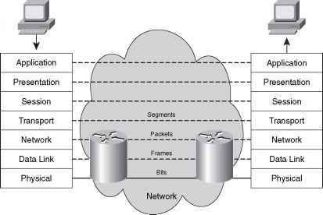
System model 1. Layered architectures
A layered communication-protocol stack,

Slide 7
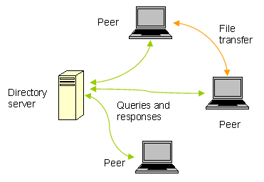
System model 1. Layered architectures
Peer to Peer domain-server network,

Slide 8
System model 1. Layered architectures
Application Layering,

Slide 9
System model 1. Layered architectures
Application Layering Processing,

Slide 10
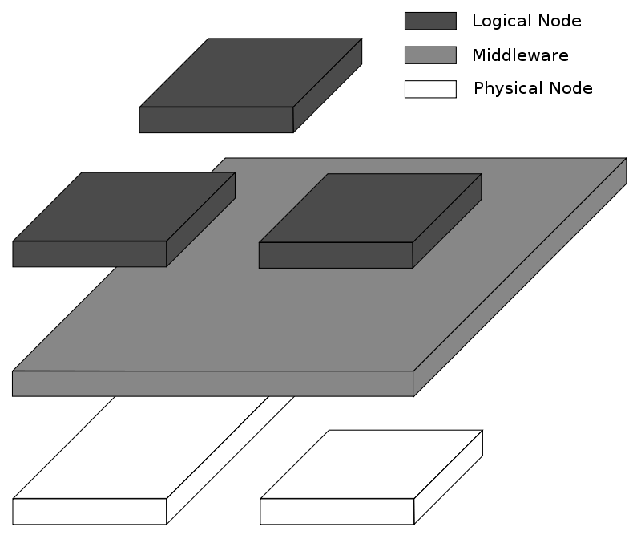
System model 1. Layered architectures
Service layering,

Slide 11
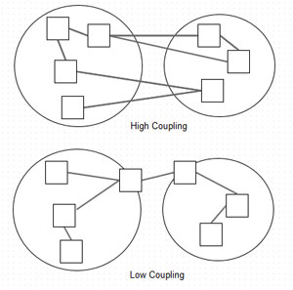
System model II. Object oriented architectures
Object Oriented, composition program function by two main principal within inherited function and encapsulated data.
High coupling, reusable object with direct access of
Accessor and Mutator.
Low coupling, reusable component with loose
dependency, use framework and xml component
dependency mapping.
such as: Sping, Maven, Gradle, Grails, Play, Laravel, Django, Go, etc.

Slide 12
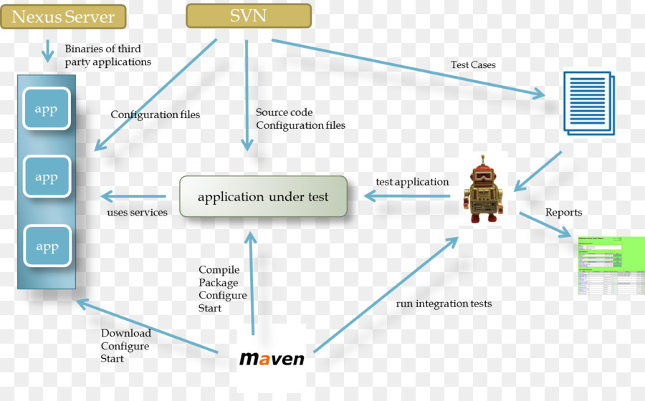
System model II. Object oriented architectures
Component Repository

Slide 13
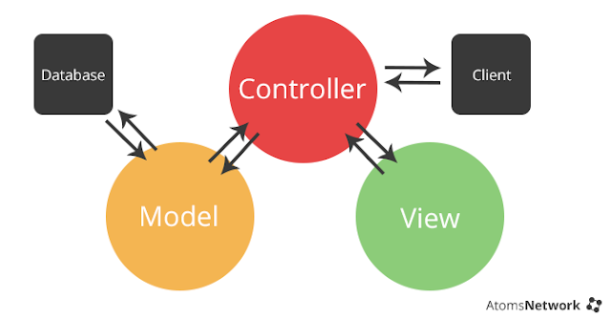
System model II. Object oriented architectures

Slide 14
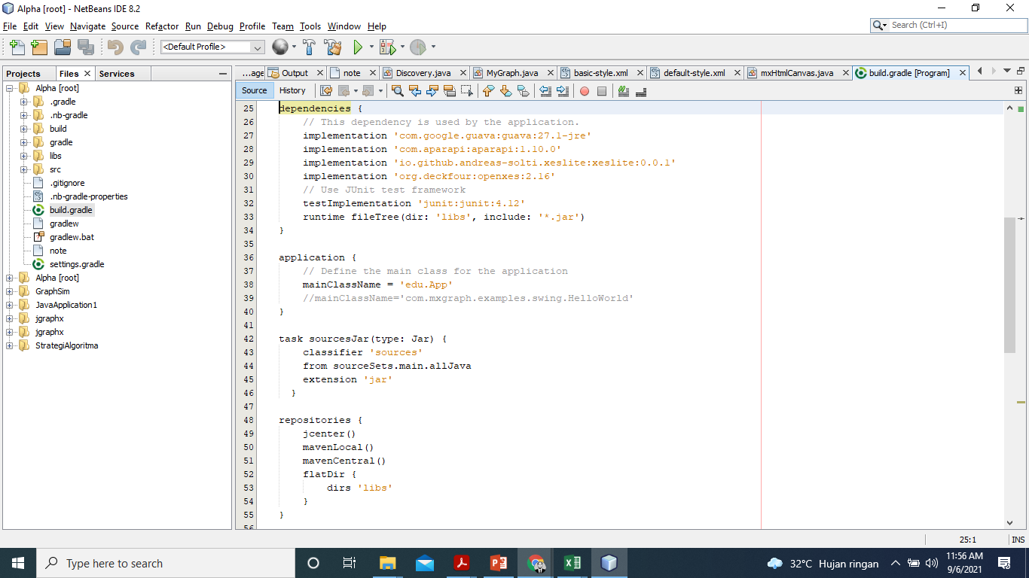
System model II. Object oriented architectures

Slide 15
System model IIi. Resource-Oriented architectures
Share and Composition web services based on content resources over networking, such as REST (REpresentational State Transfer). REST as one of the Resource-centered implementation that wrapped by HTML, JSON, or general XML with Operation Restful Http methods, such as: Post, Put, Get, Delete.

Slide 16
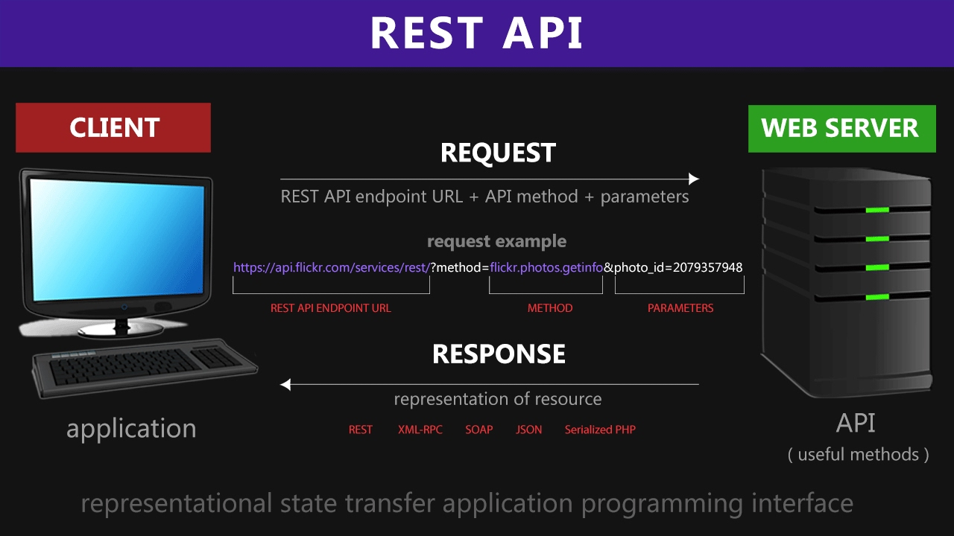
System model IIi. Resource-Oriented architectures

Slide 17
System model IV. service-oriented architectures
Service-Oriented Architecture (SOA) is a style of software design where services are provided to the other components on the heterogeneous environment through a communication protocol over a network.

Slide 18
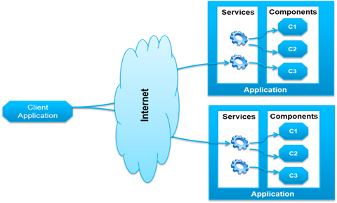
System model II. service-oriented architectures
Loose Coupling

Slide 19
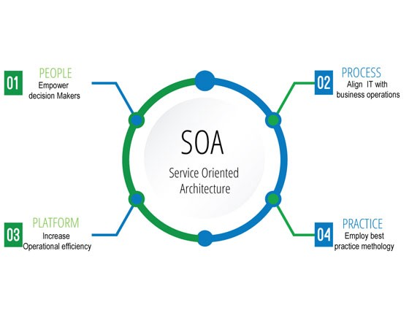
System model II. service-oriented architectures

Slide 20
System model II. service-oriented architectures
Web Services Description Language (WSDL), Simple Object Access Protocol (SOAP), and Universal Description, Discovery, and Integration(UDDI) as the service contract to exchange and composition Web-services.

Slide 21
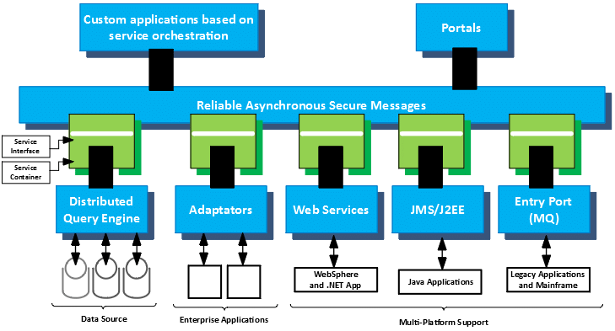
System model II. service-oriented architectures
Enterprise Service Bus:
WebSphere (Ibm)
Microsoft Azure
ORACLE-SB
Apache Camel

Slide 22
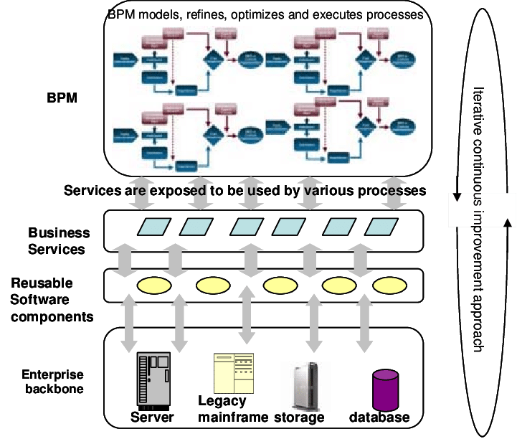
System model II. service-oriented architectures
Event Oriented SOA.

